Slide 1
Employee Performance Analysis Using Excel
NAME: G.DEEPIKA
REGISTER No: 312201315
NAAN MUDHALVAN ID: (3DE37CC5A52599C8AD547F9270556A51)asunm110312201315
DEPARTMENT: B.COM(GENERAL)
COLLEGE: D.R.B.C.C.C.HINDU COLLEGE

Slide 2
Employee Performance Analysis Using Excel

Slide 3
Agenda
Project Statement
Project Overview
End Users
Our Solution and Proposition
Data Set Description
The Wow In Our Solution
Modelling
Results
Conclusion

Slide 4
PROBLEM STATEMENT
You have been given employee performance data for the sales department, including monthly sales numbers, customer satisfaction scores, and leads generated.
Your task is to use Excel to analyze this data, identify top performers, areas for improvement, and any correlations between the metrics.
Create a comprehensive report with visualizations for management. Let me know if you need further assistance with this problem statement!

Slide 5
PROJECT OVERVIEW
In the project overview, you will be analyzing employee performance data for the sales department using Excel.
The data includes monthly sales numbers, customer satisfaction scores, and leads generated.
Your goal is to identify top performers, areas for improvement, and any correlations between the metrics.

Slide 6
WHO ARE THE END USERS
Human Resources (HR) Managers
Team Leaders and Managers
Executives and Senior Management
Employees

Slide 7
OUR SOLUTION AND IT’S VALUE PROPOSITION
Our solution involves using Excel to analyze the employee performance data for the sales department.
By examining the monthly sales numbers, customer satisfaction scores, and leads generated, we aim to identify top performers, areas for improvement, and potential correlations between these metrics. The value proposition lies in providing actionable insights to enhance the sales team’s performance and drive better decision-making based on data-driven analysis.
The detailed report with visualizations will offer a clear and compelling presentation of the findings, enabling management to make informed decisions to optimize the sales department’s performance.
Let me know if you need further clarification on our solution and its value proposition!

Slide 8
DATA SET DESCRIPTION
The data set we have includes information on monthly sales numbers, customer satisfaction scores, and the number of leads generated for each employee in the sales department.
We will be analyzing this data to evaluate the performance of the sales team members, identify top performers, areas for improvement, and explore any relationships between the different metrics.
This data will help us make data-driven decisions to enhance the sales department's effectiveness and productivity.
Let me know if you need more details about the data set description!

Slide 9
THE “WOW” IN OUR SOLUTION
Data Collection
Data Organization
Analysis
Visualization
Performance Tracking
Data Entry

Slide 10
MODELLING
1. **Data Collection**: Gather relevant data on employee performance metrics such as sales figures, project completion rates, customer satisfaction scores, etc. 2. **Data Entry**: Enter this data into an Excel spreadsheet with each row representing an employee and each column representing a performance metric. 3. **Calculations**: Use Excel functions like AVERAGE, SUM, COUNT, etc., to calculate key performance indicators (KPIs) such as average performance, total sales, etc. 4. **Visualization**: Create charts and graphs in Excel to visually represent the data. You can use bar graphs for comparing performance metrics among employees or line graphs to track performance over time.

Slide 11
RESULTS
Data: Create columns for each performance metric and rows for individual employees. (e.g., “Employee Name,” “Attendance,” “Sales,” “Project Completion”)
Averages: To find the average performance for each metric, use the =AVERAGE(range)Formula.
Totals: Sum up metrics with =SUM(range).Percentages: Calculate performance percentages with = (part/total) * 100.

Slide 12
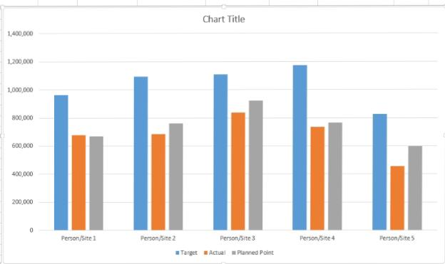
RESULTS

Slide 13
CONCLUSION
The conclusion of our analysis is that the insights gained from examining the employee performance data using Excel are invaluable for optimizing the sales team’s performance.
By identifying top performers, areas for improvement, and key relationships between various metrics, we have equipped management with the necessary information to make informed decisions and drive strategic initiatives.

